Slide 1
Python Fact!!
Python was not named after a snake.
It was named after a famous
Comedy shows on BBC
“Monty Python’s Flying Circus”
Source:- “Trust me bro.”
Oh I mean “docs.python.org”

Slide 2
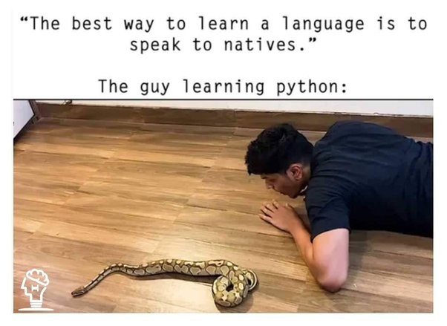

Slide 3
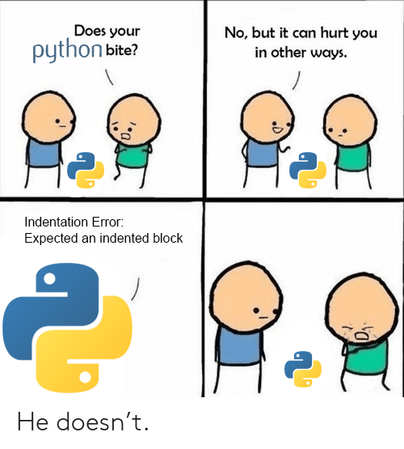

Slide 4
Python Fact!!
Python has different Variant:
CPython
Jython
IronPython
Brython
RubyPython
PyPy
MicroPython

